Slide 1
IT5420-Artificial Cognitive Systems -Machine Cognition?-
Artificial Intelligence
Intelligent systems
Computational intelligence
Artificial Cognitive System
Machine Cognition?
Artificial Neural Networks
Machine Learning
Is education in a mess?
Reading comprehension
Note-taking
13x2 training
13x39 thinking
13x239 write on paper
(cognitive device to wake up
left and right brain
Prof. Asoka S Karunananda
Senior Professor
Department of Computational Mathematics
MSc in AI B18
1
01/03/2026

Slide 2
Preamble
AI contents in different degrees
BSc Hons AI (4)
MSc in AI (2)
CS/IT/SE with AI (<2)
MSc DS & AI (<1)
MSc XX with AI < MSc in AI
Three levels of recruitment
Academia/Researchers (academia)
Professionals/Researchers (Industry)
Workforce
Only capable people will survive
Intelligence of Machines
Intelligence of humans
BrainHQ
Tai Chai

Slide 3
Preamble
AI community talks of Artificial Cognitive systems under symbolic-AI
Humanity has become more intelligent due to the use of symbolic languages for communication
Symbolic manipulation aids the thinking capacity
Recall - Education is not the learning of facts, but the training of students’ minds to think
Thinking is fundamental to all cognitive features

Slide 4
Preamble
Understanding = new knowledge + thinking + past knowledge
People/animals always get thoughts. But only people can generate thoughts or think in a desired direction (හිතනෙවා, හිතනවා)
What are the main subjects that require thinking?
Mathematics (පිළිවෙල)
Programming (algorithm)
Language
Philosophy
Gaming
Doing things systematically (පිළිවෙල/විධිමත්) is the secret of building the capacity to think
How can a lecturer wake up students’ thinking ability?
Asking the question

Slide 5
Overview
Symbolic-AI
Mathematics/Logic
Rules/Theories
Programming
Early developments
McCarthy – Stanford (ES)
Minsky – MIT (NLP)
CMU – (Game/ES)
2 = 1.414….. (algebra)
building with equal sides
1/3 = 0.3333333
0/0 = 1 → 1x0 = 2x0 → 1=2
0/0 define limits, then calculus
-1 → Complex numbers
Introduction to Artificial Cognitive Systems
Neuroscience of the Brain
Mindfulness
Cognitive Systems
Anatomy of Expert Systems
Production Systems
Classical Examples of ES
Design and Development of Expert Systems

Slide 6
Assignment
Develop an Expert System for a Local Application (health care, career guidance, legal advisory system, agriculture, transport,..)
Study applications of ES (Examples)
Tools for developing ES

Slide 7
What are cognitive systems?
What does Cognitive Science (CS) do?
In simple terms, it is about the study of the mind/brain
learning, thinking, perceiving, understanding, imagination, communication, problem-solving, creativity, intelligence, memory, walking, see, hear
CS is influenced by many subject areas:
Biology: study the structure/function of the brain
Psychology: behavior of people, anxiety, depression,
Artificial Intelligence: to simulate cognition and to study
Philosophy: identify cognitive features -cognition, learning, perception, mind/brain, memory, thinking, simulation, real
Neuroscience: classify intelligence based on the left/right brains
Linguistics: communication: human-human, human-machine, machine-machine, man-plants/animals

Slide 8
Exercise 1
Would that be fair to say that cognitive science can be confined to symbolic-AI? Justify
NO – Symbolic AI is limited to the cognitive. Performance of the left brain. But human cognition operates in both the left (symbolic) and right (training) brain. Some cognitive features (problem-solving, games, communication) operate in both brains

Slide 9
What are Cognitive (Intelligent) Tasks?
Learning (non-symbolic?)
Thinking (past, present, future)
Problem-solving
Retention (memory – basis for understanding as well)
Attention (locating the contact)
Mindfulness (Awareness - දැනුවත් බව)
Imagination (power for research)
Understanding (listening/reading/observation/doing/thinking)
Perception
Communication
Ray Kurzweil has predicted new cognitive features (ධ්‍යාන) and their operational areas in the brain will be identified in 2045
Historicallt people use ධ්‍යාන to solve problems. Those who cannot do so (No ධ්‍යාන) introduce (අධ්‍යාපනය)
Western education
-prepare the student for
the set of questions
Norway, Sweden, Finland,
Netherlands, Israel education
build students with
the capacity to solve problems
10^3 + 9^3 = 1729 = 12^3 +1^3

Slide 10
Neuroscience of the Brain
AI community appreciates NS very much because NS allows identifying basic forms of intelligence (logic/rule-based, training-based intelligence)
NS discovered that Neurons in a functioning brain emit electrical signals(Richard, 1875), EEG
Nowadays, it is found that the brain areas can be externally stimulated by electrical signals to wake up certain cognitive skills
Later, NS discovered that Neurons in other organs, hands, lungs, and legs also emit electrical signals when they function
Different locations of the brain are responsible for emitting electrical signals for different tasks

Slide 11
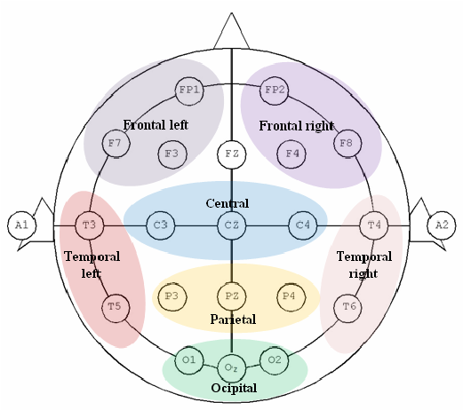
Major Areas of the Brain

Slide 12
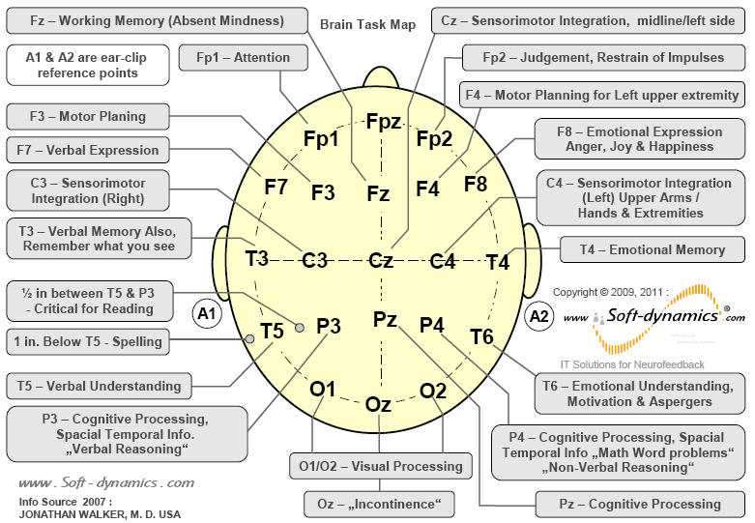
Brain Task Map

Slide 13
Exercise 2
Do you consider the brain an active and fully utilized organ? Justify your answer.
Bain prefers practice/training to think
Prefer sleeping, when doing calculations by the left, we still use the multiplication table from the right brain, we walk without thinking,
Percentage of usage
The brain has 100B neurons, but only 20% is used
The brain is underutilized; you may outsource the brain
Delegation of tasks
Brain tries to delegate tasks to hand, legs like peripheral organs as much as possible
There is lot to explore the nature of the brain.

Slide 14
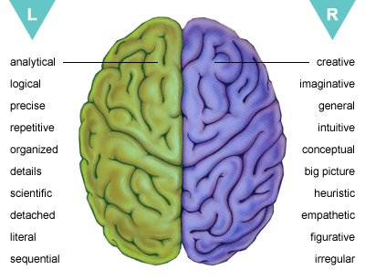
Inspirations for nature of intelligence
Knowledge Data
symbolic AI
Algorithmic Non-algorithmic
Logical/analytical Training
ES/XCON, DART ES/Watson
ACS ML
Learning
Logic Antilogic
Data→ Knowledge (F=ma) work of scientists
Knowledge → Data done by ordinary people

Slide 15
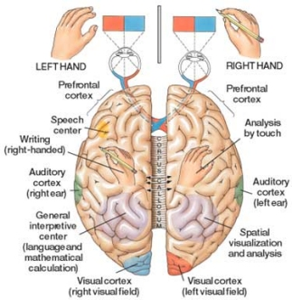
Both sides are important
The higher the cross-connection (corpus callosum) stronger the intelligence
Mindful walking build the cross-connection
How does walking
meditation
Form corpus callosum
Distinguishing Left/right
Legs - left brain activity
Detect sensations
right brain

Slide 16
EEG Brain Waves
Electrical activity can be captured externally by Electroencephalography (EEG) Technology (Berger, 1934, after 60 years from Richards)
An EEG signal primarily comprises different frequency ranges, named as , , ,  and 
, , , , and  in increasing order of frequency
All the tasks/locations emit electrical signals as a combination of the above waves
p, q, r, s, t - p,q,r,s,t to be determined

Slide 17
EEG Brain Waves

Slide 18
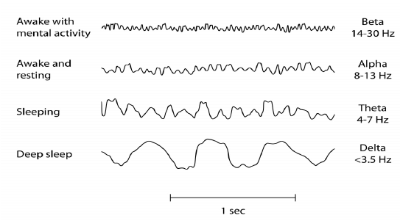
EEG Waves

Slide 19
Details of Wavebands
Wave Band | Frequency | Functions
Delta (Sleep) | 0.5-3Hz | Deep sleep, unconsciousness, anesthetic conditions
Theta (Drowsy) | 4-7Hz | Dreaming sleep, deep meditation, drowsy, problem solving
Alpha (Relax) | 8-13Hz | Consciousness, relax, not thinking, Blinking
Beta (Active) | 14-30Hz | Concentration, Alertness, working, Thinking, anxiety, fear, stress
Gamma (Excited) | 31-50Hz | Cognition, Perceptual activity, memory recall

Slide 20
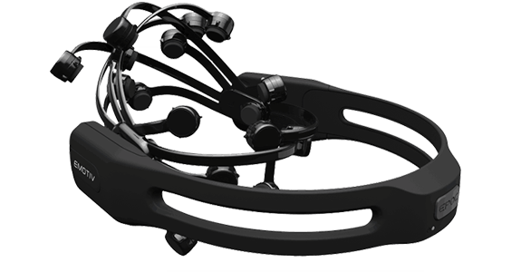
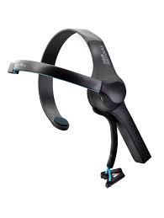

Capturing Brain waves
Emotive EPOC
NeuroSky Mindwave
Muse

Slide 21
Homework for next week
Conduct a survey on devices to capture EEG waves
Number of sensors
Status of sensors (dry/wet)
Which kind of application
Access to raw data for our analysis
Cost
Portability
Usability
………..
Do the presentation next week
2
08/03/2026

Slide 22
Exercise 3
Discuss any confusion about the term Artificial Cognitive System. (Machine Cognition)
Older names are controversial
Artificial Intelligence
Artificial Cognitive Systems
Artificial Neural Networks
New areas do not use the word Artificial
Natural Language processing
Computer Vision
Robotics
Ontology
MAS
Fuzzy Logic
AI Agent?
Artificial Neural Networ →Machine Learning (Aurther Samuel, 1952)
Intelligent Machines
Machine intelligence
Intelligent Systems
Computational intelligence
Artificial Intelligence
බුද්ධිමය යාන්ත්‍ර විද්‍යාව

Slide 23
Note
First (before 2000), we model knowledge-intensive AI solutions using rules/logic (symbolic AI - ACS)
After 2000, we model data-intensive AI solutions (non-symbolic – ML)
In the future, we model brain waves using EEG/fMRI/PET/CT/ to develop AI solutions
We need algorithms to program (symbolically) all this knowledge, data, and EEG to run on Von-Neumann machine
Therefore, AI community cannot forget symbolic AI

Slide 24
Features of the brain
The brain has two major parts: the left/right brains
Brain manifests two forms of intelligence: logical/training
Two parts are mutually beneficial
It has many features: intelligence, memory, …
Mindfulness energizes other cognitive features
Only 20% of the brain is active
Only humans have a thinking brain
But nature promotes the right brain (faster)
Functioning brain emits electrical signals
Different parts of the brain is responsible for different tasks
Raw material for left/knowledge, right/data

Slide 25
Mindfulness
Attention is all you need
Ashish Vaswani
Transformer
Long-sighted
දුර දෘෂ්ඨිකත්වය
Universal Joint
සර්වලෝක පූට්ටුව
Mindfulness (not filling the mind but free) (සතිය/සිහිය) is a cognitive skill
It is primarily a way of paying Attention (becoming aware)
It has many characteristics
Be in the present moment (but you can be attentive to past and future)
Paying Attention to one (main) object (lecture, windshield)
Reorientation (go out and get back to the main object)
Driving (side mirrors), following a lecture (example)
Executive control (quickly be attentive to new serious objects/events)
Suddenly apply the brakes
Non-judgmental (good/bad)
It is not about concentration, but there is momentary concentration
Concentration (shoot a steady target)
Mindfulness (shoot a moving target)
In driving or following lectures, we cannot limit ourselves to concentration but require awareness of the vicinity. This is called mindfulness

Slide 26
Mindfulness..
Mindfulness development has many benefits
Mindfulness can energize all the other cognitive skills
attention, awareness, alert, thinking, training, retention, understanding, imagination (research), memory, analytical skills, perception
Emotional balance (desire, anger, depression, anxiety, well-being)
Ability to recall/remind when required (exam, wakeup, 255)
Enable solving problems that were never solved by you before
By practicing mindfulness, you can understand the ultimate truth
Some activities demanding mindfulness
Mathematical calculations, shooting, medical surgery, reading, writing
You cannot be mindful (attentive) about two things at the same.
In trained tasks – can do the task without attention – low mindfulness

Slide 27
Exercise 4
If you are doing an activity for which you are trained. Discuss the status of mindfulness during that activity.
Trained means low mindfulness, effortless, less attention, right brain
Naturally, the mind does not like thinking but enjoys training
Whenever possible mind likes to stop thinking and enjoy dreamless sleeping
If you are mindful, why do you feel relaxed?
If you are mindful, the mind is engaged in one task only
Why do students find it difficult to learn something?
Learning requires thinking
How does mindfulness energize thinking?
Thinking involves sending the mind to the past and future. This leads to the mind wondering. If you are mindful mind does not wander, but works under notice.

Slide 28
Mindfulness…
According to Buddhism, mindfulness is the only
path to understanding even the ultimate truth
There are many ways to develop mindfulness
Contemplating (paying attention to) Bodily experience (sitting, walking, breathing) - කායානුපස්සනා
Contemplating Sensory experiences (heat, pressure, pain, cold) වේදනානුපස්සනා
Contemplating Mind/thoughts (past, future, outsider, animal)
චිත්තානුපස්සනා
Contemplating mental characteristics (anger, sleepy, worry)
ධම්මානුපස්සනා

Slide 29
Simple techniques for Mindfulness
Counting down from 100 by reducing 1 at a time
Counting down from 100 by reducing 3 at a time
Spell your surname in reverse order (Perera, Samaranayake)
Scanning the body sensation up and down
Sweeping
…..
Watch videos
https://www.youtube.com/watch?v=3ItUFIqSHnk

Slide 30
How understanding works
Understanding is a cognitive feature that belongs to education
How we understand something
Listening/Reading (සුතමය)
Thinking (චින්තාමය)
Being aware/experiencing/through attention (භාවනාමය/සතිය)
General thinking for understanding (wondering)
Past knowledge+Current Knowledge+Thinking→ understanding
Guided thinking for understanding
Past knowledge+Current Knowledge+Mindfulness→ understanding
We develop new ideas and theories when we relax (being aware), but do not necessarily think (Newton, Archimedes, Schrodinger)

Slide 31
Exercise 5
Identify which cognitive skill is promoted in our education system
At present, it is a memory
Einstein promoted thinking in education
Developing mindfulness, all thinking, memory, etc. will also develop
Discuss how mindfulness is different from thinking
Mindfulness – aware/attentive to the state of the mind
Thinking – sending mind to Past and Future – risk (wandering)
What is the relationship between training and mindfulness?
Mindfulness – left (Fp1)
Training – right
Left → right function of the brain
Mindfulness
Thinking
Memory
Understanding
Training

Slide 32

Applications of mindfulness - Medicine
, , , , and 
Deep sleep
Sleep
3
15/03/2026

Slide 33
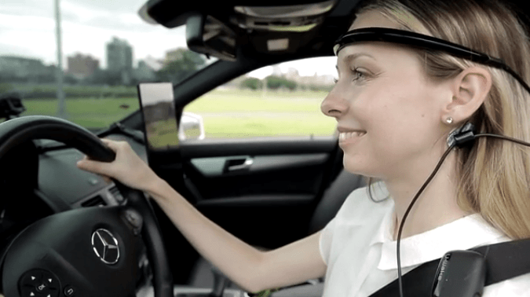
Applications of mindfulness - Driving
p, q, r, s, t
Which brain waves can be studied in this session? ,, ,

Slide 34
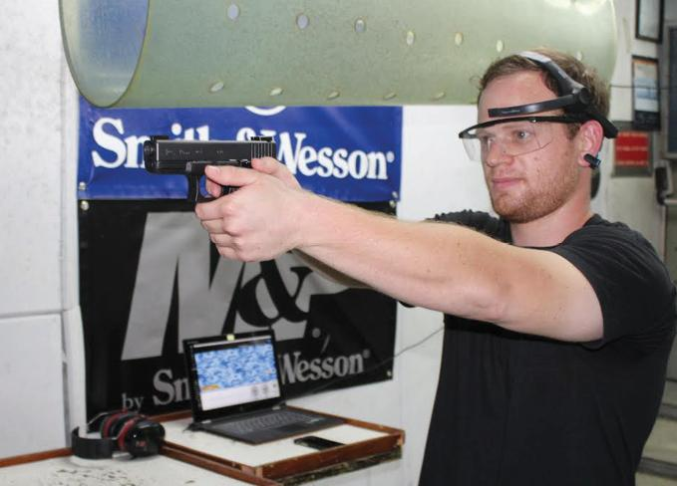
Applications – Military

Slide 35

Applications of mindfulness - Education
EEG: Non-invasive
Neuralink - Invasive

Slide 36

Applications of mindfulness - Meditation

Slide 37
Exercise 6
Survey applications of EEG technology.
Medicine, Training, Education, Criminal investigation, Study of the brain, controlling robots, playing games. Brain-machine interfacing, cursor movement by thinking, mind-mind communication, military, entertainment, the study of behavior of animal/human,
How can disabled people use EEG technology?
Driving knowledge
Medicine
Military data
Military knowledge
Military information

Slide 38
Mindfulness studies in Sri Lanka
Sati pasala foundation
Visit – www.satipasala.org
Project on EEG analysis

Slide 39
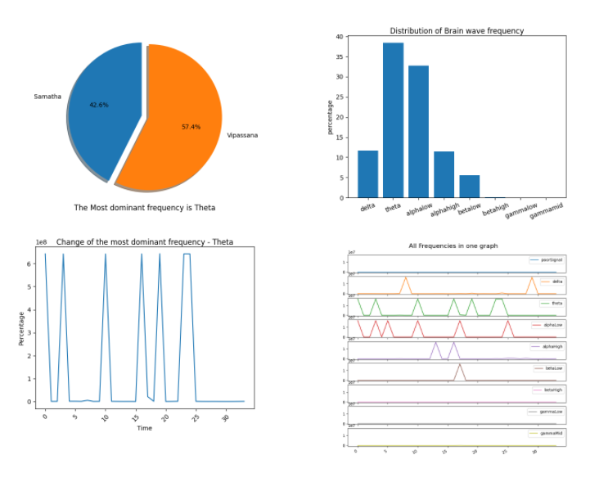
Mindfulness studies in Sri Lanka

Slide 40
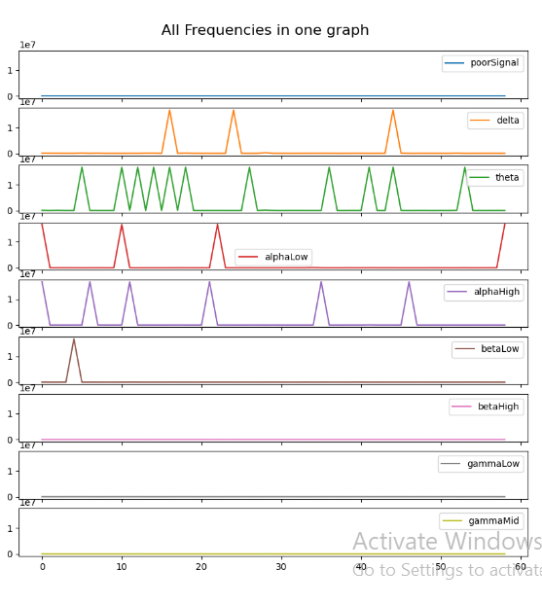
When mindfulness
is low. What has happened?
At this time
Alpha high occurs.
So, no sleeping

Slide 41
Exercise 4
Identify the finding of EEG analysis (previous slide) for mindfulness.
For a mindful session,  is the dominant frequency
 is the second highest
 should be small (otherwise you fall asleep during mindfulness training)
 and  are as small as zero, because the session is mindfulness oriented
If  > , you are concentrating but not mindful
Our tradition of mindfulness goes with developing , while Western practice is about 
Research – national relevance (cobra) + international recognition (antivenom)

Slide 42
Brain Computer Interfacing
Capturing EEG signals and processing on a Computer for different purposes comes under BCI (Brain Computer Interfacing) – The smart car key can be extended with BCI
Mind-machine communications
lower arm robot – brain (Bluetooth and EEG)
Opening/closing a door by thinking
Mind-mind communication
Machine-mind communication (neural link)
Future keyboard, mouse, and microphone will be replaced by BCI
EEG signals are to be preprocessed to identify , , ,  and  wave related to a particular tasks
Note: Any task has a combination of all waves
There are other brain imaging techniques like PET, CT, fMRI

Slide 43
Exercise 7
Identify whether the following cognitive features can be implemented by symbolic or/and non-symbolic approach to AI? In each case give examples.
XCON
DART
Knowledge
Explainability
Reliable
Cognitive Feature | Symbolic/non-symbolic
Learning | Learn from theory/learn from training
Thinking | Thinking involves Math, games, and problem-solving
Retention | Non-symbolic, but can be developed by symbolic manner
Problem solving | Symbolic and non-symbolic
Mindfulness | Fp1 – largely symbolic
Understanding | Shown in both sides of the brain
Perception | Both

Slide 44
Cognitive systems
Certain cognitive tasks have already been built as following cognitive systems
Cognitive feature | AI technique to implement
Perception | Robotics, Agent
Leaning | ML,ES, Robotics
Reason out (problem solving) | MAS, ES, Search
Communication | NLP, Chatbot, MAS
Make decision

Slide 45
Exercise 6
Discuss the importance of communication (the use of symbols) for the evolution of the intelligence of mankind
Communication enables the sharing of knowledge
Discovering new knowledge
Communication requires a language
Human languages are symbolic-based
The higher the symbolic usage smarter the intelligence
Question - Why cannot our mathematics students write well when mathematicians (Harking, Russell, Newton) are good writers?
Reading has not been encouraged for mathematics students. Therefore, they cannot get the benefit of reading, such as improving vocabulary and nice patterns of writing. This amounts to poor reading comprehension and poor expressive power.
Reading comprehension is so weak in humanity in general

Slide 46
What are cognitive systems?
From a computational viewpoint Cognitive systems deal with symbolic (controversial) manipulations of knowledge
Manipulation of intelligence via stored knowledge as rules/theories/logic/frames comes under knowledge representation or knowledge modeling (1970s)
Examples of cognitive systems
Expert Systems
Natural Language Processing
Image Processing
Game Player
MAS
Each cognitive system has its own specific cognitive features.
NLP deals with communication, understanding, translation, generation

Slide 47
Knowledge modeling to modern trends
Logic-based  Expert systems
Rule-based  Expert systems/NLP/Game/Search
Only logic can handle P  (Q, R), but not rules
Semantic Networks  Frames/Ontology/LLM/RAG
Frames  Object-oriented
To model something, we use another thing involving the 1st thing
intelligence is modeled by knowledge
thinking is modelled in Game, Problem-solving)
--

Slide 48
Exercise
Which of thinking or mindfulness is the boss, given that all cognitive features are fundamental to thinking?
Although thinking is fundamental, it tends the mind to wander to the past and the future. Unless the thinking is guided, this capacity is useless. Mindfulness enables guided thinking and also energizes all cognitive features
Dog (thinking) and belt (mindfulness)

Slide 49
Expert Systems – A cognitive system
Expert Systems (ES) are considered a classic example of the cognitive system and the oldest AI technique
McCarthy - Stanford(ES)/CMU(XCON, ALVIN, Deep Blue, KM)
ES made AI popular in the early days (XCON-industry, DART-public)
ES are also called Knowledge-based systems (KBS)
ES has specific cognitive features (problem-solving, communication, perception)
ES is a computer program that can solve problems like a human expert (grandmother, carpenter, doctor, mother, engineer, counselor, trip-advisor, farmer, lecturer, technician)
Most experts present their knowledge as rules, procedures, etc.
4
22/03/2026

Slide 50
Exercise 7
Can all Experts express how they do things?
Some experts may not have even literacy to express their ideas. This is one problem in the construction of ES
Can all the Expert Systems be considered only under symbolic AI (Artificial Cognitive Systems)?
Expertise is not limited to knowledge but also includes training experience. Think of a doctor.

Slide 51
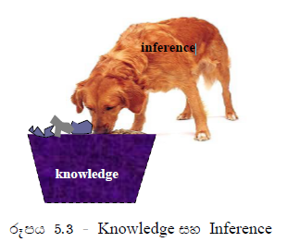
Philosophy of Expert Systems
We all know that Experts are intelligent
Building the Expertise into a computer was a challenge
Inspiration for the philosophy of Expert Systems
Experts’ knowledge comes in two forms:
Subject/Domain-specific knowledge
Problem-solving knowledge
Best analogy – Dog digging in a bin https://www.youtube.com/watch?v=FNcjyrZuP_0
Benefits of maintaining two separate bodies of knowledge
Ease of maintenance
Increased reusability of problem-solving knowledge, across domains)
Increase portability
Updating ….

Slide 52
Exercise 8
Explain how the philosophy of ES applies when a student prepares for a GCE (A/L) like examination.
Two tuition masters -
Based on the philosophy of ES, which makes two medical doctors in the same field give different diagnoses for a set of symptoms
Problem-solving knowledge is different.
Under what conditions can the same Expert give two different answers to the same question?
Doctors use different pieces of problem knowledge
Patient gives new information, like a new symptom/report

Slide 53
Exercise 9
Would the philosophy of ES and Neuroscience of the brain tell the same thing?
ES viewpoint: domain knowledge/problem solving
NS viewpoint: analytical/training
They are not the same, because domain knowledge could be both analytical and training knowledge.
Domain knowledge could be both analytical and training knowledge. Further, problem-solving knowledge could be both analytical and training knowledge. Therefore, two views are not the same

Slide 54
Domain (subject) knowledge
Example for Subject-specific knowledge of an Expert
Heart diseases
Design of Buildings
Configuring Computers
Transport and logistics
Manufacturing, Agriculture, Defense, Education, Health care, Finance, counseling, career guidance
Fault diagnosis in vehicles/electrical systems,
Without domain knowledge, nothing can be done even in machine-learning applications, why?
A doctor has the knowledge to interpret data in a report and make conclusions. But ordinary people cannot do so, why?
Given that a blood
The report has data
of medical
Parameters, why
do you go a medical
Doctor?
The doctor has knowledge
in medicine

Slide 55
Exercise 9
Give examples of dynamic knowledge
Stock prices
Weather information
Telecom billing information
Population, Exchange rate, pressure, sugar,
……..
Give an example of static knowledge
F=ma
Heat goes from high temp to low temp
Covid information
DoB,

Slide 56
Problem solving knowledge
Also called inference (problem-solving) knowledge
Problem-solving knowledge operates on domain knowledge
They would be applicable across the domain
Search, FC/BC reasoning, TT/EQ/IR/CNF, simple thing first, most familiar first, already visited the place first,
More examples for problem-solving strategies
Solving from data to goal (FC)
Solving from goal to data (BC)
Solve the simple thing first
Solve the familiar thing first
………

Slide 57
Exercise 10
Military/Admin
Teaching
Children Learn
Knowledge
Intelligent
Study Skills
Interest in scientists
Reading Comprehension
Thinking/understanding
Note taking
Identify 5 problem-solving techniques practiced by major Politicians.
Divide people
Postponing elections
Passing bills against the media
Concession packages
Bribe the members of parliament
Planting stories related to religion, ethnic groups,
Creating a crisis on fuel, gas,

Slide 58
Homework
(1) Identify FIVE areas where ES has been used.
(2) Survey toolkits for building ES.
(3) Prepare for discussion next week

Slide 59
Features of Expert Systems
Think about the tasks by experts like
Doctor/lawyer/engineer/Architect/counsellor/teacher
ES operates in narrower areas rather than broad areas
But DART, Watson, ES has addressed a biological limitation of humans, handling a large number of parameters
ES dominates in asking questions
More questions are asked by the doctor of the patient (MIS?)
ES can handle incomplete information
(i) Ask questions, (ii) Make assumptions, (iii) ignore
ES Provide alternative solutions
Buying a laptop, prescribing antibiotics,

Slide 60
Features of Expert Systems ……
ES can give a level of assurance
Level of assurance (probability) of each answer
Gives Recommendations rather than exact answers
Since experts see many dimensions, they see uncertainty, multiple options, and incomplete information; they would rather give recommendations.
ES uses heuristics and experiences over theories
Without a test, a doctor writes prescriptions, why?
Provide reasons for answers (explainability with certainty)
Doctor refer to rule used D:-F,V, R, 80%
Doctor refer to rule used D:-F,V, 70%

Slide 61
Exercise 11
By considering a technician at a computer shop, describe how the following ES features apply
Operate on a narrow domain (we do only SW, upgrade, repair)
ES dominates by asking the question (software update?)
Incomplete information (not booting, power ok?)
Alternative solutions (memory upgrade, SSD)

Slide 62
Exercise ….
Give real-world examples using ES where the following situations are involved
Alternative solutions are required (medicine, shopping)
Assurance of an answer is required (counselling,
After a discussion, a doctor prescribes a test, which ES feature is executed by the doctor?
Asking for a report means the doctor has not gone enough

Slide 63
Why Expert Systems?
To extend MIS/LLM/ML solutions
To assist human experts (Doctors, Lecturers, Lawyers)
To reduce the cost of accessing human experts
To access the expert when not in the desired location
To clarify a decision/action
To preserve experts’ knowledge as ES (beyond books)
Avoiding mistakes due to biological limitations
To improve accuracy and efficiency
When handling special/new/unknown/incomplete situations
Marketing experts’ knowledge (e-channeling manager)
Saving experts’ time (surgeon does only surgery )
ES has expertise of more than one expert
5
29/03/2026

Slide 64
How Expert Systems work
ES executes in a different manner than MIS
Starting a dialog by a patient telling symptoms (fever)to a doctor
When hearing symptoms (fever, headache, red eyes, body ache), the doctor recalls rules/diseases, etc. related to these symptoms
Recollecting symptom-related things called the conflict set with R1, R2, R3
Conflict Resolution – arrange rules in order of priority
R2, R1, R3 (simple rule first, first come first served, ….)
Two doctors use two different priority orders of rules
Missing Information – R2 dengue:- fever(given), vomiting (missing)
Alternate Solutions – dengue:- fever, vomiting,
food-issue:- fever, headache
Uncertainty Handling – Z:- X, Y, 20% Z :- X, Y, J, 80%
Explanations – use conditions of the rule to explain the answer
dengue:- fever, headache, red eyes
All the steps are based on the conflict set for decision-making
These steps are the magic of ES (problem solving knowledge)

Slide 65
Exercise 12
Which of the following is the most important aspect to
decide on the expertise of an Expert?
Expert forming the Conflict Set (symptoms, dialog)
Conflict Resolution (setting priority order with rules)
Missing information (of the selected rules)
Alternate solution (having a solution, look for another)
Uncertainty (when more than one solution)
Explanation (based on the rule used)
Note: conflict set is usually updated dynamically

Slide 66
In modern ChatGPT-like systems, the interaction process, like in ES, is called prompt engineering (conflict set)
Explain how prompt engineering works when a child meets a doctor? (accompanying father/mother)

Slide 67
Exercise 13
Discuss how the following things can happen
How the execution of ES different from that of MIS
Conflict resolution (choice of correct rule/option)
How do ES handle missing information
Asking questions, making assumptions, ignoring, using different/new sources (report, expert, past reports)
How do ES systems handle alternative solutions
ES needs additional information from the client or another source
Use a different rule from the conflict set of ES

Slide 68
Exercise 14
Identify which of the following situations can be modeled by expert systems technology. In each case, give reasons
Hotel reservation system (alternative, uncertainty, explanations)
Arithmetic calculations
Self-driven
Online purchase of books
e-Channeling
ES is suitable for any situation with incomplete information, requiring alternative solutions, explanations, and level uncertainty, which may be more like recommendations than exact answers

Slide 69
Homework
Study how Watson, Google Assistant-like software, differs from conventional Expert Systems
What is the main difference between classical ES and modern ES like Chatbots/Watson?
Identify related ES features for the following symbolic AI solution
ES, NLP, Robotics, Game

Slide 70
Exercise 15
Identify methods that an Expert System could use to handle missing information
Asking questions
Assumptions
Ignore/Guess (imagine)
Getting from an external source, like a medical report
Describe how Expert Systems technology can address the issue of explainability in ML solutions.

Slide 71
Assignment
Download an Expert System Shell and study how to build an Expert System.
Build an expert system concerning local context and do a demonstration.
More marks will be given for the choice of a good local application to construct an expert system
It should demonstrate the essential characteristics of an ES.

Slide 72
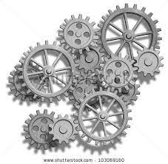


Anatomy (Architecture) of Expert Systems
User Interface
UI
NLP
KR
Representation as
logic/rules
Reasoning
FC/BC/
Inference Engine
Problem-solving knowledge
Search
SQL
DB
Knowledge Base
-domain knowledge-
LLM

Slide 73
Exercise 16
Which component of ES architecture mainly differentiates expert systems from database systems?
Discuss which Topics in the module on Essentials of AI have supported the building of Expert Systems architecture
Knowledge representation – Knowledge based
Inference engine – reasoning(FC,BC), search techniques

Slide 74
User Interface
Provides access to
Developers
Users
Administrators
Handle various forms of inputs/outputs
Asking questions (input)
Acquiring missing information
Giving answers (output) →
Explanations, Alternative solutions, assurance

Slide 75
User Interface
Some interfaces enable NLP features
Communication through natural languages
Asking questions in plain English
Handling Voice, texts, images, videos, EEG
Chatbots are the best example of those features
Now chatbots are being replaced by AI Agent
Interfaces
Desktop/web/mobile interfaces/BCI devices
Use of multimedia features
Easy access to web resources
Authentication
ELIZA
Chatbot/AI Agent
LLM

Slide 76
Homework
Identify Expert System development tools, with
Desktop interface
web interface
Mobile interface (App)

Slide 77
Exercise
To what extent can you consider ChatGPT as an ES?
ChatGPT has a pre-trained LLM (may be wrong), like KB (assured experts’ knowledge) is ES
ChatGPT is based on ML, early ES Symbolic, but now symbolic + ML (Watson)
As an ML, ChatGPT cannot explain the answers.
ChatGPT is NLP-based, and has a simple UI
Expert problem solving (ES)
Learning (ML/ANN)
Perception (Robotics)
Thinking (Game)
Understanding
languages in context
(ChatGPT)

Slide 78
Knowledge Base….
It’s a reservoir of knowledge such as
Special knowledge (music, military, national security)
Databases/Data sets
Web servers
File servers
Cloud
Digital Libraries
E-books
LLM
It could include
Data (noisy, incomplete, dynamic)
Information
Knowledge
Rules/Theories
Procedures
Unless proper knowledge representation is used KB cannot be accessed by the inference engine

Slide 79
Knowledge Base….
We must use appropriate KR techniques (rules, logic, etc.)
to code the KB
KB may include so many modules
If BFS/DFS (Search -IE) is to
explore the knowledge base,
what would be the suitable
KR in KB? (tree or graph-rules)
Flex
has a dll to fetch data
from the Access database to
Flex KB
Knowledge Base (LLM)
Disease diagnosing
Static knowledge module
Treatments Module
Disease prevention
Dynamic knowledge module
Interpreter 1
Interpreter 2
External Database
Web server
Knowledge from external sources should be transformed
into KR structures through interpreters (parsers)

Slide 80
Knowledge Base….
KB uses various KR techniques to store knowledge
Rules
Logic
Frames
Semantic Networks
Ontologies
Knowledge graphs
Knowledge from other sources (e.g. Web) must be converted to one of such forms to be used by the expert system
Check Flex Expert System shell?
6
05/04/2026

Slide 81
Exercise 18
What is the most powerful knowledge representation technique? Justify your answer
Logic – Only logic can resolve P(Q^R)
What is the most popular knowledge representation technique among others?
Rules - Simple structure enabling update, extension, FC/BC
How/why can rules contribute to improving the reasoning power of other KR techniques?
They can be converted to predicate logic expressions, and then write Prolog programs
P(Q^R)
P → (Q ^ R) (Q ^ R) → P
If Q, R, then P
Q
P
R

Slide 82
Inference Engine
IE is the power of ES technology
IE works on the knowledge base
IE does the intelligent reasoning on the KB
This makes ES different from conventional IS
For intelligent reasoning, IE uses various problem-solving strategies
Search
Forward/backward chaining
Conflict resolution (simple first, complex first, frequently-used first, first-come, first-served, known first, least traffic, shortest path, road condition, cheapest, uncommon/usual, misguiding)
Uncertainty handling

Slide 83
Inference Engine…
Compatibility between KB and IE is required
Otherwise, IE should work on a DB and create an ES
IE can be used in the domain independently
IE can be designed to run on a client/server side
Built-in IE and UI with an empty KB – called an ES shell
All features of ES are in IE
Alternative solutions
Explanations
Uncertainty
Incomplete information
Conflict resolution

Slide 84
Client/Server Architecture for ES
Desktop (powerful PC)
Client-server (powerful)
Cloud (HW+SW services)
Agentic Architecture
You are planning for a
Batch trip
Location
Transport
Accommodation
UI+IE+KB on one machine
UI+IE client (desktop), but KB on a server (Web)
UI client (mobile), IE+KB on one server -
UI client, IE on one server + KB on another server
UI client - IE+KB server (cloud)
Mobile app client - UI+IE+KB server (cloud)
Today, we say that expert systems can handle even time-critical applications. Why?
Cost for powerful HW and SW is available as services

Slide 85
Exercise 18
Discuss how ES differs from MIS, one can be replaced by the other?
ES - intelligent reasoning/experts are not able to handle large amounts of data
MIS – storing and managing large amounts of data
Can a database directly be used as a KB of an ES? Justify your answer.
No. sKB requires special forms like rules and logic to represent knowledge. Therefore, without introducing an interpreter/ a parser between database and KB the connection cannot be made.
ES
MIS

Slide 86
Production Systems (rule-based ES)
Production system is a special kind of ES that uses rule-based representation in the KB
Widely used class of expert systems to date
Because rule-based representation can be used for various types of knowledge
Procedures
Laws
Theories
Recipes
Instructions
Orders

Slide 87
Production Systems
Why rule-based representation is so good
The structure of a rule is very simple
Comprehensive to include and, or, not, variables, etc.
Rules can be easily modified
Structure is extendible to include uncertainty, etc.
Other representations can also be converted into rules, using predicates (e.g. is_a(cat, animal), address(name, no, street, city)
DB
Semantic Networks
Frames
……
Prolog languages use facts and rules to write programs. The facts and rules are written as predicate logic expressions. Prolog uses rules a special type of rule, called Horn clauses with non-negative term in the Head
Rules offer very simple but powerful two-reasoning techniques

Slide 88
Reasoning under uncertainty
Knowledge is always changing, incomplete, and noisy
Weather forecasting (tempt., humidity, windspeed, ….)
Medical diagnosis (D → Red, Red → D???)
Stock market prediction
Thus, reasoning under uncertainty is a real need
Also called non-deterministic or probabilistic reasoning
Many techniques used for reasoning under uncertainty
Probability theory (Bayes’ theorem )
Fuzzy Logic
Specific techniques like MYCIN calculus
Note: Logical reasoning gives deterministic reasoning

Slide 89
Conditional probability
Conditional probability
When one event has happened, there is a probability of another event happening
For a given disease, a Doctor knows symptom P(S|D)
In real life, a patient goes with symptoms, and the doctor has to diagnose the disease. P(D|S)??
This occurs since the same symptom can apply to many diseases.
Challenge - How a doctor concludes a disease from the symptoms
Here we use the concept of conditional probability
During MBBS
Doctor learns
P(S|D)
But when the doctor
practices he has
to determine
P(D|S)?

Slide 90
Conditional Probability
P(A|B) = P(A with B)/P(B) = P(AB)/P(B)
When B has happened, there can be many subsequent events like A, C, D,…..Therefore we isolate A with B as above.
P(A|B) = P(A ^ B)/P(B)

Slide 91
Example 13
Reporting a toothache, the doctor could not catch a cavity
Not knowing toothache, the doctor could catch a cavity (good)
 | Toothache |  | ➢toothache
 | catch | ➢catch | catch | ➢catch
cavity | 0.108 | 0.012 | 0.072 | 0.008
➢cavity | 0.016 | 0.064 | 0.144 | 0.576
The doctor collects data
Name toothache cavity no cavity Catch not catch
Jagath 1 1 0 1 0
Nimal 1 1 0 0 1

Slide 92
Knowing a Problem is different from ability catch the problem
This is why some doctors, and technicians like people cannot
always diagnose and detect problems.

Slide 93
Example …..
P(cavity|toothache) = P(cavity toothache)/P(toothache)
= (0.108+0.012)/(0.108+0.012+0.016+0.064)
= 0.120/0.2 = 0.6
P(-cavity|-toothache) = P(-cavity -toothache)/P(-toothache)
= (0.144+0.576)/( + + + )
= 0.82
Exercise
Find the probability that a doctor will say that you have a cavity although you have no toothache
P(cavity|-toothache) = 0.072/0.8 = 0.09

Slide 94
Exercise 14
symptoms
 | Fever |  | ➢Fever
 | Catch | ➢catch | catch | ➢catch
+PCR
➢PCR
Diagnosis
If the health ministry wants to maintain a covid database in the above manner, identify the variables names for the purpose. (Hint: , Fever, ) Also suggest some realistic values for the cells regarding Sri Lankan context.

Slide 95
Bayes’ theorem
Combine the following result from Conditional probability
Using P(A|B) = P(A B)/P(B) we can write the following
P(A|B) = P(A B)/P(B) → P(A B) = P(A|B)P(B)
P(B|A) = P(A B)/P(A) → P(B A) = P(B|A)P(A)
Then we get the Bayes’ Theorem
P(B|A) = P(A|B)P(B)/P(A)
P(Dengue|Fever) = P(Fever|Dengue)P(Dengue)/P(Fever)
Two patients with fever coming from Gall and Kandy may have different probabilities regarding P(dengue)/P(fever)
It is also easy to design experiments with Bayes’ theorem
Medical note

Slide 96
Example 15
Suppose a doctor knows from medical research that dengue causes vomiting, say 60%of the time. The doctor also knows that a person having dengue is 5% in a certain area. Further, the doctor knows that 7% is the probability that a person has vomiting in that area. Find the probability of a patient having dengue if he has the symptom of vomiting.
Dengue, vomiting
We are looking for P(D|V)?
P(D), P(V), P(V|D)

Slide 97
Example…
Then, we can write
P(vomiting|dengue) = 0.6
P(dengue) = 0.05
P(vomiting) = 0.07
P(dengue|vomiting) = P(vomiting|dengue)P(dengue)/P(vomiting)
= 0.6 x 0.05 /0.07 = 0.03/0.07 = 0.4285
Universal
local
local

Slide 98
Exercise 16
Suppose a technician deals with repairing computers. He gets computers with the symptom of the slowdown in the machine even with one or two applications. He has found low memory is the problem for this. If the technician wishes to record symptoms and problems for his decisions, how the experiment should be conducted?
Symptom Problem Environment
slowdown memory
slowdown software
not booting ……….
Compute P(D|S)
In addition, to compute P(S), P(D) he needs data like a brand of computer, old/new, also need to know P(S|D)

Slide 99
Expert System vs. Recommender Systems
Knowledge Base vs. Data-Driven: Expert Systems are built upon a rigid, pre-defined knowledge base created by human experts. Recommender Systems are trained on large datasets (Big Data) to discover patterns themselves
Adaptability: Expert systems are poor at handling uncertainty and cannot learn from new data, whereas AI-based recommenders excel in dynamic, changing environments.
ACS
No regular update
ML
regular training
required

Slide 100
Purpose: Expert systems (ACS) are designed for high-precision tasks like medical diagnosis (e.g., MYCIN). Recommender systems are designed for personalization in e-commerce or content streaming (e.g., Netflix, YouTube).
Transparency: Expert systems provide clear logic behind their answers. Many recommender systems, especially those using deep learning, act as "black boxes."

Slide 101
Classical expert systems-DENDRAL
McCarthy (Stanford) is the father of ES
He also developed the LISP language (MIT, 1958)
Note: Prolog was developed in the 1970s
DENDRAL (Feigenbaum at CMU, 1964) –world 1st ES
It determines molecular shapes (chemistry) of a given compound, using mass spectroscopic data.
DENDRAL uses the rule-based knowledge representation
DENDRAL has a planner module to determine the most possible molecular structure by satisfying various constraints.
7
19/04/2026

Slide 102
Classical expert systems-PROSPECTOR
PROSPECTOR was developed by SRI International (Stanford Research Institute)
It was developed during 1976 -1981 to evaluate geological sites for mining
Richard Duda, John Gaschnig, Peter Hart, Rene Reboh, Nils Nilsson.
Its use rules and semantic nets for knowledge representation

Slide 103
Classical expert systems-MYCIN
Developed by Buchanan & Shortliffe at Stanford University (1984)
MYCIN is a production system (rule-based system)
Perhaps the most cited ES in the history of AI
It diagnoses bacterially infected blood disease and suggests treatments –but not used in medicine, yet used to teach ES
MYCIN necessary uses backward chaining,
Because diagnosis starts by assuming a disease
Suggesting treatments use forward chaining,
Because many options are possible
MYCIN was written in LISP another symbolic programming language (but not logic programming like Prolog)
EMYCIN – Shell (ROGET, THERESIA)
Dendral-1960s
Prospector – 1970s
MYCIN -1980s

Slide 104
Classical expert systems-MYCIN..
MYCIN provides facilities for
Consultation (interaction with the patient)
acquisition of knowledge (incomplete information)
Explanation
MYCIN rule format embeds the uncertainty as well
If (i) the stain of …. And
(ii) the ……
then there is suggestive evidence (0.7) that the identity of organism is ……….. (next page)
MYCIN’s KB has been structured for static and dynamic (acquired information during consultation) knowledge
IE of MYCIN can handle incomplete information, uncertainty, and alternate solutions as well

Slide 105
A MYCIN Rule example
From LLM (ChatGPT)
you can use RAG
to build a specialized
Small LLM (Heart
disease) and use it
as KB for ES
Here you can simply
Use ChatGPT interface
for the ES without bothering
IE and UI.
ES is more reliable due to
Assured knowledge
ChatGPT is more powerful
in reasoning.
IF: 1) The gram stain of the organism is gramage, and
2) The morphology of the organism is rod, and
3) The aerobactin of the organism is anaerobic
THEN: There is suggestive evidence (.6) that the
The identity of the organism is bacteroid
Note:
The rule in plain English, without predicate
The rule first shows conditions then the conclusion
The conclusion embed the uncertainty
Explains are obtained from the rule: since conditions you say the conclusion

Slide 106
Homework
AI is for building
Agents to do the
Right thing.
Read the research papers on the following ES
DENDRAL
PROSPECTOR
MYCIN (why MYCIN?, MYCIN for what purpose?)
XCON (why?, purpose?, institute?)
DART

Slide 107
Classical expert systems -XCON
286
386
486
Pentium
XCON developed by McDermott (1982/84) at CMU
XCON gave industry recognition for AI after 30 years
It configures (designs, plans, schedules) the minicomputer by identifying memory, CPU, tapes, etc. to suit with user requirements
XCON could configure a computer in a (i) few minutes with 100% accuracy, (ii) DEC saved millions and increased shares
It necessarily uses forward chaining. Why?
begin with conditions and reach possible innovative goals
It is rule-based and has a simple rule format
If: the most current …….
Then, assign a disk driver to the mass-bus
Uncertainty handling is not encouraged in XCON, why?

Slide 108
Classical expert systems-DESIGN ADVISOR
Analysis (diagnosis)
Synthesis (design)
Identify areas where
design the advisor model
of ES can be used
Fashion design
Medical diagnosis
UIUX design
Draft thesis to supervisor (analysis)
Incorporating comments
(synthesis)
DESIGN ADVISOR (Steel et al, 1989)
It critiques chip design
For a requirement, DESIGN ADVISOR proposes a design
In design problems, ES is better than humans due to biological limitations
Then the human Designer can accept or reject the advice
If it is rejected, DESIGN ADVISOR, try alternative solutions
Rule format
If: the sequential level count of ELEMENT..
Then: critique for poor testability
DEFEAT: poor testability of ELEMENT
Due to: …….
By: ELEMENT is …
McCarthy, Minsky, ES, NLP, ML, Robotics, Agent, Game

Slide 109
Classical expert systems-DART
DART (Cross and Walker, 1994) dynamic data analysis and replanning tool in the Gulf War by the US (Stanford/CMU and IBM)
Autonomous logistic planning concerning a large amount of 50,000 entities beyond human capacity
It shows ES can work in large domains as well
ES can consider multiple dimensions in problem-solving, and it is not the case with human ES
Could attack the targets with pinpoint accuracy
US Defence said that 30 years of funding for AI research has been recovered from DART

Slide 110
Exercise 16
Discuss why an ES (expertise from many experts) could be better than a Human Expert in a particular subject area.
Answers to the following questions:
Why are ANN, GA, MAS, ES better than the expertise of a single human expert?
Why can GA produce better solutions over generations? (chromosomes, genes, cloning, cross-over, mutation, fitness function)

Slide 111
Design and Development of ES
Knowledge Engineering
Knowledge Level Modeling
Approaches to develop ES

Slide 112
Road Map
People start to model intelligence for AI solutions
Modelling intelligence
Intelligence – search
Knowledge is the main ingredient of intelligence – knowledge modeling – knowledge representation, knowledge level (rules, logic, ….)
Large dataset – data modeling (ML)
LLM (knowledge) ----- transformer -→ data → ML solutions
EEG
Capturing motions of humans/animals as data (Boston Dynamics, Avatar, AlphaGo, India)

Slide 113
Knowledge Engineering (know how)
Knowledge Engineering
Knowledge Science?
Software Engineering
Software Science?
Information Technology
Information Science?
Wasko agama - 1505
Science – 17th Century
The area that designs and develops Intelligent Systems is called knowledge engineering
The person who is involved in knowledge engineering is called a Knowledge Engineer
Knowledge engineer acquires knowledge from the domain Experts and develops an executable code of ES
There is always a gap between what the Expert thinks and what the KE has understood
Human Expert
Knowledge Engineer
Expert System

Slide 114
Knowledge Modelling
Modelling knowledge for intelligent systems has revolutionized AI
All ES, NLP, Games, LLM, etc., are knowledge-intensive systems
Developing ES needs certain knowledge of Modelling
Like System Analysis and Design in Software Engineering?
KM is difficult since knowledge is very unstructured, incomplete, diversified, and subjective
Allen Newell (CMU) introduced the concept of Knowledge Level to model knowledge
All ES development environments are expected to support the knowledge-level modeling

Slide 115
The Knowledge Level
Knowledge Level
knowledge modelling
Program (symbol) level
Programming level
Register transfer sub circuit level
Logic Circuit sublevel
Circuit level
Device level

Slide 116
Exercise
Who is the most influential person to promote ES?
John McCarthy promoted ES (Artificial Intelligence, LISP, Intelligence is logic-based)
What is the ingredient of intelligence used in ES?
Knowledge
Expertise of different experts could be training-based and/or logic-based? Justify your answer
Carpenter/driver (training)
Doctor/Mathematician (theory + training)
Laws, Procedures, pure mathematics (knowledge rules)

Slide 117
Approaches to develop ES
Programming from scratch
Tools for specific tasks like Diagnose and Design
Expert System Shells
Generic Approaches
Any problem-solving in this world can be seen as
Diagnose (Analysis)
Design (Synthesis)
MYCIN, DART
XCON, written
from scratch
8
26/04/2026

Slide 118
Programming from scratch
This approach requires people to code the following from scratch
User interface
Inference engine
Knowledge base
Database connectivity
Web connectivity
Although intelligent reasoning is the key to ES, this requires other things to be in place.
To make ES more practical, we need other technologies
Storage (databases/Ontology/Websites), Cloud, Networking, LLM,
If one’s own programming language/environment is used, it reduces security threats for the system

Slide 119
Programming from scratch..
Exercise
Identify technology that can implement each of the modules stated in the previous slide. Also, name the kind of persons required for such a development project.
Required technologies for UI (jave), IE (search, FC/BC, ), KB (rule, logic
Programmers are not limited to AI-qualified people
CS/IT/SE/CE
KB/IE - you need AI people with Expert Systems, Search/Knowledge Rep, ML

Slide 120
Tools for specific tasks
General tools support ES from acquiring knowledge to the executable code are hard
It would be practical to develop toolkits for specific tasks
For instance, toolkits for developing ES for tasks like diagnosis and design are possible
Such toolkits generally support the following tasks
Entering knowledge
Maintaining knowledge base consistency
Ensuring completeness of the knowledge base

Slide 121
Analysis/Synthesis
Analysis (Diagnose) | Synthesis (Design)
Fault in a car | Assembling a computer
Look mango in a fruit stall | Schedule a trip
Debugging a software | Cooking of potatoes
Search for loss key | Design an online legal advisory system
Syntax error | Buying a laptop
 | Look for partner for marriage
 | Explaining reasons
 | Research
SE life cycle brings analysis and synthesis together

Slide 122
Tools for specific domains - MOLE
MOLE by Eshelman (CMU, 1988) supports developing ES that can do the task of diagnosing (breaking into parts)
Fault in a circuit, disease, errors, …….
It uses cover-and-differentiate method of problem-solving
MOLE acquires knowledge to differentiate various categories of problems (if the car does not start, he needs differentiation knowledge for motor, battery, fuel, and AC)
If an expert is clever, he should have strong differentiation knowledge. (if a person reports a stomach problem, Dr eventually recommends a CT scane of the brain)?
Doctor
Diagnose
MOLE
Cover and differentiate

Slide 123
Tools for specific task - MOLE
Steps by MOLE to construct knowledge base
Step1
MOLE asks the expert to list common complaints or diseases that would require a diagnosis
Then for each symptom, MOLE acquires a list of possible explanations
If a symptom has more than one explanation, MOLE tries to acquire differentiate knowledge from the expert to determine the conditions under which that explanation is correct
Step 2
Refine the developed expert system in consultation with human expert

Slide 124
Tools for specific domains - MOLE
Applications of MOLE
diagnose problems with car engines
steel-rolling mills
coal-burning power plants
Disease diagnosis in medicine
However, MOLE is not suitable for tasks such as designing
Think of a doctor diagnosing a disease by using differentiation knowledge to isolate a disease for a given symptom – cover and differentiate

Slide 125
Tools for specific tasks - SALT
SALT by Marcus and McDermott (CMU, 1989) implements modeling of design (planning, scheduling, configuring, discovering) problems (putting together)
It uses the problem-solving method called propose-and-revise
Propose-and-revise method builds the solution incrementally
Assume an architect designs a house and meets the client. Here, the client proposes that the architect revise the design accordingly. – propose and revise
Analysis Synthesis
Diagnosis Design
MOLE SALT
Cover-and propose-
differentiate and revise

Slide 126
Tools for specific domains - SALT
Steps in execution of SALT
As the first step, the system proposes an extension to the current design.
Then SALT checks whether the extension violates any constraints (local or global). Any constraints violation is fixed, and repeated the process.
Note: Domain experts are good at listing whole parameters and design constraints, but not that good at explaining how to arrive at a global solution. This is addressed by proposing solutions and by revising them incrementally
Architect
Design
SALT
Propose-and-revise

Slide 127
Expert system Shells
It is a toolkit with the following key components
User interface (built in)
Inference Engine (built in)
Empty Knowledge Base (to be filled)
ES Shells also give facilities for
Database connectivity (KB)
Web integration (KB)
NLP features (UI, IE, KB)
Integration with different interfaces (Web, DTop, Mobile
ML integration (KB, IE)
Mobile interface
LLM integration

Slide 128
Homework
Identify 10 areas where ES technology has been used. Justify the need for ES for such a domain.
Agri, Banks,
Crime data analysis and alerts
Small business planning ES
These areas involve incomplete information, alternative solutions, explanation, uncertainty, DART/XCON ………..

Slide 129
Exercise
Can you simply delete the KB of an Expert system to construct an Expert System Shell?
What does it really mean when you say, I’m using an ES shell to develop an ES?
If ML did not develop with recent advancements, what could have happened to AI?

Slide 130
Expert system Shells….
ES Shells are ideal for the rapid development of ES
ES Shells is the most commercially viable approach to develop ES
Some Shells
CLIPS
ExpertA
Drools
Flex
…

Slide 131
Expert system Shells….
Exercise
Study an ES Shell and identify features offered by the Shell and the HW and SW requirement to develop and run an ES

Slide 132
Generic Approaches
People would like to have ES development toolkits that support the entire life cycle from requirement analysis to maintenance of ES, like in UML design
Specific tools and ES Shells do not support a full life cycle, but coding without much knowledge of modeling
There are generic approaches to meet this requirement
Generic Tasks (US)
Role Limiting Methods (US)
Component of Expertise (Belgium)
KADS (EU)

Slide 133
Generic Tasks
Chandrasekaran (1985) proposes that reasoning or inference can be decomposed into several subtasks, which are called the Generic Task (GT).
Generic Tasks identified by Chandrasekaran
Classification (analysis)
Abstraction
Synthesis
Hypothesizing (making assumptions)
Abduction (opposite of deduction)
Note: GT’s Chandrasekaran has not provided any theoretical basis
Cooking
cleaning
chopping
adding spicy
fry/cock

Slide 134
Generic Tasks
Using GT approach, ES is modeled in terms of Task structures that include
Tasks
Subtasks
Methods related to task/subtasks
To acquire tasks and methods, he proposed a method called PVCM
Propose use an angle grinder to repair the body of a car (task)
Verify technician says no, and say we do manual sanding
Critique grinder destroys the body
Modify sanding

Slide 135
Role Limiting Method
McDermott(1988) has proposed a special class of problem-solving methods to model ES
They are called role-limiting methods (RLM).
This methodology assumes that each task (role) is associated with a method to perform the task
Note that MOLE and SALT that we discussed are products of this thinking
As such cover-and-differentiate (diagnose) and propose-and-revise (design) are some RLM.
More importantly, these two methods can model ES for any domain

Slide 136
Chandrasekaran (GT) - Task and Methods
Promoted tasks
McDermott (RLM) - Role and Methods
Promoted methods called RLM
McCarthy (intelligent is logic-based) ES
Minsky (intelligence is anti-logic-based as well) NLP

Slide 137
Component of Expertise
Luc Steels (1990) has proposed to integrate features of GT, RLM and KADS like approaches to develop a more comprehensive methodology
It is named as Component of Expertise (CoE).
CoE approach encourages looking at the acquisition of experts’ knowledge in terms of
Task identification
Decomposition of tasks
Investigation of methods

Slide 138
KADS
KADS stands for Knowledge Analysis and Design Support
output is a set of design diagrams/descriptions
KADS supports until design diagrams, but not the development of an executable code for an ES
KADS approach (Weilinga et al, 1992) is well recognised as a structured method to model ES
It proposes a four-layer architecture for modelling ES

Slide 139
Four-layer architecture of KADS
Strategic layer
Task layer
Inference layer
Input, functions, output
Domain layer
concepts, relationships

Slide 140
Domain layer
The domain layer of KADS methodology proposes to acquire experts’ knowledge in terms of concepts and relations in the particular domain.
This process is very similar to data modelling view of traditional software development.
As such domain layer modelling can be supported by ER diagrams, Class diagrams, etc.

Slide 141
Inference Layer
It is about the structuring of knowledge in terms of input function and output.
Graphical representation of input-function-output is known as an inference structure
Modelling at the inference layer is comparable with data flow diagrams in traditional software modelling.
Raw vege
Wash
Clean vege

Slide 142
Task layer
Task layer develops what is called task structures to achieve a certain goal as per the inference structures developed
To achieve a certain goal, we may have to connect several inference structures to form a task structure.
Inference structures for wash and cut are connected
As per KADS, a task structure should integrate inference structures by showing goal, methods applied to each function and control knowledge.
It should be noted that task structures have a similar theme to state transition diagrams in traditional software modelling.

Slide 143
Strategic Layer
The strategic layer modeling in KADS is concerned with the control knowledge identified in the task structures.
Connection inference structures to form the task structures in not unique (Design for the same shopping cart application cannot be the same)
However, there were not clear explanations about the modelling at the strategic layer.

Slide 144
What is KADS-2 (CommonKADS)?
Latest developments in KADS, known as KADS-2, provides a more detailed life-cycle approach to knowledge modelling that includes
project management
organisational analysis
knowledge acquisition
conceptual modelling
user interaction
system integration
design.

Slide 145
Notes on Generic approaches
They talk of knowledge level modeling
They are based on modeling primitives such as input, output, tasks, methods, inference structures, task structures
Identification of tasks/subtasks and methods are fundamental to modeling the knowledge
These methodologies have been developed into various toolkits

Slide 146
Tools/Workbenches
XShelly is the implementation of KADS
GT-Toolset implements GT
MOLE and SALT implements RLM
A workbench offers many tools into one place
Such tools include
Automated laddering tools – ALTO
Repertory grids
There are also various implementations of generic approaches

Slide 147
Exercise
Discuss to what level Expert system shells can be considered as generic approaches to develop ES.
ES shells have limited facilities for knowledge modelling, such as hierarchical, rules, and no design, but shells offer executable output. On the other hand, generic approaches offer nice building blocks for knowledge modelling, tasks, methods, roles, …
How can you improve generic approaches to produce executable ES?

Slide 148
Knowledge modelling was a main research area in the 1990s.
However, knowledge modelling (handcrafting knowledge) was complicated without a unified method
By 2000, people found lots of data from internet transactions, online, and deep learning was introduced to model that data.
In 2010, LLM (knowledge) came forward
Transformer could extract data from LLM
That data could be used to develop ML solutions for LLM (knowledge)

